Slide 1
CH13 Cloud and IoT Security
ZJU 2020
Notes:
This chapter provides an overview of computer security. We begin with a discussion
of what we mean by computer security. In essence, computer security deals
with computer-related assets that are subject to a variety of threats and for which
various measures are taken to protect those assets. Accordingly, the next section of
this chapter provides a brief overview of the categories of computer-related assets
that users and system managers wish to preserve and protect, and a look at the
various threats and attacks that can be made on those assets. Then, we survey the
measures that can be taken to deal with such threats and attacks. This we do from
three different viewpoints, in Sections 1.3 through 1.5. We then lay out in general
terms a computer security strategy.
The focus of this chapter, and indeed this book, is on three fundamental
questions:
1. What assets do we need to protect?
2. How are those assets threatened?
3. What can we do to counter those threats?

Slide 2
Outline
Cloud computing
Cloud security approaches
Cloud security concepts
The Internet of Things
IoT security
Notes:
The patching vulnerability
IoT security and privacy requirements defined by ITU-T
An IoT security framework
An open-source IoT security module

Slide 3
Cloud Computing:
NIST defines cloud computing, in NIST SP-800-145 (The NIST Definition of Cloud Computing, September 2011) as follows:
“Cloud computing: A model for enabling ubiquitous, convenient, on-demand network access to a shared pool of configurable computing resources (e.g., networks, servers, storage, applications, and services) that can be rapidly provisioned and released with minimal management effort or service provider interaction. This cloud model promotes availability and is composed of five essential characteristics,
three service models, and four deployment models.”
Notes:
NIST defines cloud computing, in NIST SP-800-145 (The NIST Definition of Cloud
Computing ) as follows:
Cloud computing: A model for enabling ubiquitous, convenient, on-demand network
access to a shared pool of configurable computing resources (e.g., networks,
servers, storage, applications, and services) that can be rapidly provisioned and
released with minimal management effort or service provider interaction. This
cloud model promotes availability and is composed of five essential characteristics,
three service models, and four deployment models.

Slide 4
Notes:
The definition refers to various models and characteristics, whose relationship
is illustrated in Figure 13.1. The essential characteristics of cloud computing include
the following:
• Broad network access: Capabilities are available over the network and accessed
through standard mechanisms that promote use by heterogeneous thin or thick
client platforms (e.g., mobile phones, laptops, and tablets) as well as other traditional
or cloud-based software services.
• Rapid elasticity: Cloud computing gives you the ability to expand and reduce
resources according to your specific service requirement. For example, you may
need a large number of server resources for the duration of a specific task. You
can then release these resources upon completion of the task.
• Measured service: Cloud systems automatically control and optimize resource
use by leveraging a metering capability at some level of abstraction appropriate
to the type of service (e.g., storage, processing, bandwidth, and active user
accounts). Resource usage can be monitored, controlled, and reported, providing
transparency for both the provider and consumer of the utilized service.
• On-demand self-service: A cloud service consumer (CSC) can unilaterally
provision computing capabilities, such as server time and network storage, as
needed automatically without requiring human interaction with each service
provider. Because the service is on demand, the resources are not permanent
parts of the consumer’s IT infrastructure.
Resource pooling: The provider’s computing resources are pooled to serve
multiple CSCs using a multitenant model, with different physical and virtual
resources dynamically assigned and reassigned according to consumer demand.
There is a degree of location independence, in that the CSC generally has no
control or knowledge of the exact location of the provided resources, but may
be able to specify location at a higher level of abstraction (e.g., country, state,
or datacenter). Examples of resources include storage, processing, memory,
network bandwidth, and virtual machines (VMs). Even private clouds tend to
pool resources between different parts of the same organization.

Slide 5
Cloud Service Models
Three service models: Platform as a Service (PaaS), Infrastructure as a Service (IaaS), Software as a Service (SaaS)
Notes:
NIST SP 800-145 defines three service models , which can be viewed as nested service alternatives:
software as a service (SaaS), platform as a service (PaaS), and infrastructure
as a service (IaaS).

Slide 6
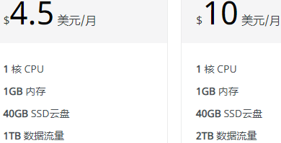
Three Cloud Service Models
Software as a service (SaaS): Provides service in the form of application software running on and accessible in the cloud
e.g., webmail (Gmail, QQ mail, 163 mail…)
Platform as a service (PaaS): Provides service in the form of a platform, including hardware infrastructure, software building blocks, development tools, runtime environments, and other tools that assist in deploying the customer’s own applications
e.g., Google App Engine
Infrastructure as a service (IaaS): Provides the customer access to the hardware infrastructure, including processing, storage, networks, and other computing resources so that the customer is able to deploy and run arbitrary software
e.g., Aliyun

Slide 7
NIST Deployment Models
Public cloud
The cloud infrastructure is made available to the general public or a large industry group and is owned by an organization selling cloud services
The cloud provider is responsible both for the cloud infrastructure and for the control of data and operations within the cloud
Private cloud
The cloud infrastructure is operated solely for an organization
It may be managed by the organization or a third party and may exist on premise or off premise
The cloud provider is responsible only for infrastructure and not for control
Community cloud
The cloud infrastructure is shared by several organizations and supports a specific community that has shared concerns
It may be managed by the organizations or a third party and may exist on premise or off premise
Hybrid cloud
The cloud infrastructure is a composition of two or more clouds
Notes:
NIST defines four deployment models :
• Public cloud: The cloud infrastructure is made available to the general public
or a large industry group and is owned by an organization selling cloud
services. The cloud provider is responsible both for the cloud infrastructure
and for the control of data and operations within the cloud.
• Private cloud: The cloud infrastructure is operated solely for an organization.
It may be managed by the organization or a third party and may exist on
premise or off premise. The cloud provider is responsible only for the
infrastructure and not for the control.
• Community cloud: The cloud infrastructure is shared by several organizations
and supports a specific community that has shared concerns (e.g., mission,
security requirements, policy, and compliance considerations). It may be
managed by the organizations or a third party and may exist on premise or
off premise.
• Hybrid cloud: The cloud infrastructure is a composition of two or more
clouds (private, community, or public) that remain unique entities but
are bound together by standardized or proprietary technology that enables
data and application portability (e.g., cloud bursting for load balancing
between clouds).

Slide 8
Deployment Models Comparison
 | Private | Community | Public | Hybrid
Scalability | Limited | Limited | Very high | Very high
Security | Most secure option | Very secure | Moderately secure | Very secure
Performance | Very good | Very good | Low to medium | Good
Reliability | Very high | Very high | Medium | Medium to high
Cost | High | Medium | Low | Medium
Table 13.1
Comparison of Cloud Deployment Models
Notes:
Table 13.1 lists some of the relative strengths and weaknesses of the four cloud
deployment models.

Slide 9
Cloud Computing Reference Architecture
NIST SP-500-292 (NIST Cloud Computing Reference Architecture) establishes reference architecture, described as follows:
“The NIST cloud computing reference architecture focuses on the requirements of “what” cloud services provide, not a “how to” design solution and implementation. The reference architecture is intended to facilitate the understanding of the operational intricacies in cloud computing. It does not represent the system architecture of a specific cloud computing system; instead it is a tool for describing, discussing, and developing a system-specific architecture using a common framework of reference.”
Notes:
NIST SP 500-292 (NIST Cloud Computing Reference Architecture, September 2011) establishes reference
architecture, described as follows:
The NIST cloud computing reference architecture focuses on the requirements
of “what” cloud services provide, not a “how to” design solution and implementation.
The reference architecture is intended to facilitate the understanding of
the operational intricacies in cloud computing. It does not represent the system
architecture of a specific cloud computing system; instead it is a tool for describing,
discussing, and developing a system-specific architecture using a common framework
of reference.

Slide 10
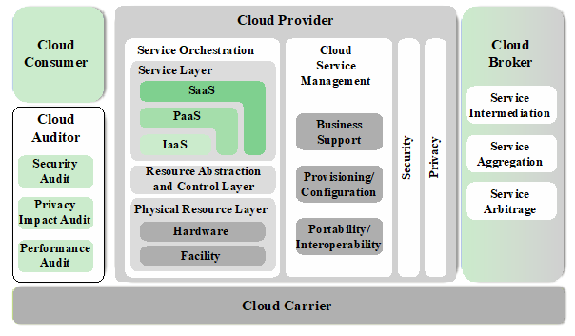
Actors in the Ref Architecture
Five major actors in terms of the roles and responsibilities:
Cloud service consumer (CSC): A person or organization that maintains a business relationship with, and uses service from, cloud providers.
Cloud service provider (CSP): A person, organization, or entity responsible for making a service available to interested parties.
Cloud auditor: A party that can conduct independent assessment of cloud services, information system operations, performance, and security of the cloud implementation.
Cloud broker: An entity that manages the use, performance, and delivery of cloud services, and negotiates relationships between CSPs and cloud consumers.
Cloud carrier: An intermediary that provides connectivity and transport of cloud services from CSPs to cloud consumers.
Notes:
The reference architecture, depicted in Figure 13.3, defines five major actors in
terms of the roles and responsibilities:
• Cloud service consumer (CSC): A person or organization that maintains a business
relationship with, and uses service from, cloud providers.
• Cloud service provider (CSP): A person, organization, or entity responsible for
making a service available to interested parties.
• Cloud auditor: A party that can conduct independent assessment of cloud services,
information system operations, performance, and security of the cloud
implementation.
• Cloud broker: An entity that manages the use, performance, and delivery of
cloud services, and negotiates relationships between CSPs and cloud consumers.
• Cloud carrier: An intermediary that provides connectivity and transport of
cloud services from CSPs to cloud consumers.
The roles of the cloud consumer and provider have already been discussed.
To summarize, a cloud service provider can provide one or more of the cloud services
to meet IT and business requirements of cloud service consumers . For each of the
three service models (SaaS, PaaS, IaaS), the CSP provides the storage and processing
facilities needed to support that service model, together with a cloud interface
for cloud service consumers. For SaaS, the CSP deploys, configures, maintains, and
updates the operation of the software applications on a cloud infrastructure so that
the services are provisioned at the expected service levels to cloud consumers. The
consumers of SaaS can be organizations that provide their members with access to
software applications, end users who directly use software applications, or software
application administrators who configure applications for end users.
For PaaS, the CSP manages the computing infrastructure for the platform and
runs the cloud software that provides the components of the platform, such as runtime
software execution stacks, databases, and other middleware components. Cloud
consumers of PaaS can employ the tools and execution resources provided by CSPs
to develop, test, deploy, and manage the applications hosted in a cloud environment.
For IaaS, the CSP acquires the physical computing resources underlying the
service, including the servers, networks, storage, and hosting infrastructure. The IaaS
CSC in turn uses these computing resources, such as a virtual machine, for their fundamental
computing needs.
The cloud carrier is a networking facility that provides connectivity and transport
of cloud services between cloud consumers and CSPs. Typically, a CSP will set
up service level agreements (SLAs) with a cloud carrier to provide services consistent
with the level of SLAs offered to cloud consumers, and may require the cloud carrier
to provide dedicated and secure connections between cloud consumers and CSPs.
A cloud broker is useful when cloud services are too complex for a cloud consumer
to easily manage. A cloud broker can offer three areas of support:
• Service intermediation: These are value-added services, such as identity management,
performance reporting, and enhanced security.
• Service aggregation: The broker combines multiple cloud services to meet consumer
needs not specifically addressed by a single CSP, or to optimize performance
or minimize cost.
• Service arbitrage: This is similar to service aggregation except that the services
being aggregated are not fixed. Service arbitrage means a broker has the flexibility
to choose services from multiple agencies. The cloud broker, for example,
can use a credit-scoring service to measure and select an agency with the best
score.
A cloud auditor can evaluate the services provided by a CSP in terms of security
controls, privacy impact, performance, and so on. The auditor is an independent entity
that can assure that the CSP conforms to a set of standards.

Slide 11
Interactions between Actors
Three types of networks.
The Data Center Network of the CSP consists of racks of high-performance servers and storage devices, interconnected with high-speed Ethernet switches.
The Enterprise Network of the CSC typically includes a number of LANs, servers, workstations, PCs, and mobile devices, with a broad range of network performance, security, and management issues.
The Cloud Carrier, which is shared with many users, cab create virtual networks with appropriate SLA and security guarantees.
Notes:
Figure 13.4 illustrates the interactions between the actors. A cloud consumer
may request cloud services from a cloud provider directly or via a cloud broker. A
cloud auditor conducts independent audits and may contact the others to collect
necessary information. This figure shows that cloud networking issues involve three
separate types of networks. For a cloud producer, the network architecture is that of
a typical large datacenter, which consists of racks of high-performance servers and
storage devices, interconnected with high-speed top-of-rack Ethernet switches. The
concerns in this context focus on virtual machine placement and movement, load
balancing, and availability issues. The enterprise network is likely to have a quite
different architecture, typically including a number of LANs, servers, workstations,
PCs, and mobile devices, with a broad range of network performance, security, and
management issues. The concern of both producer and consumer with respect to the
cloud carrier, which is shared with many users, is the ability to create virtual networks,
with appropriate SLA and security guarantees.

Slide 12
Security Issues for Cloud Computing
Security is a major consideration when augmenting or replacing on-premises systems with cloud services
Allaying security concerns is frequently a prerequisite for further discussions about migrating part or all of an organization’s computing architecture to the cloud
Availability is another major concern
Auditability of data must be ensured
Businesses should perform due diligence on security threats both from outside and inside the cloud
Cloud users are responsible for application-level security
Cloud vendors are responsible for physical security and some software security
Security for intermediate layers of the software stack is shared between users and vendors
Cloud providers must guard against theft or denial-of-service attacks by their users and users need to be protected from one another
Businesses should consider the extent to which subscribers are protected against the provider, especially in the area of inadvertent data loss
Notes:
Security is important to any computing infrastructure. Companies go to great lengths
to secure on-premises computing systems, so it is not surprising that security looms as
a major consideration when augmenting or replacing on-premises systems with cloud
services. Allaying security concerns is frequently a prerequisite for further discussions
about migrating part or all of an organization’s computing architecture to the cloud.
Availability is another major concern.
Generally speaking, such questions only arise when businesses contemplating
moving core transaction processing, such as enterprise resource planning (ERP)
systems, and other mission critical applications to the cloud. Companies have traditionally
demonstrated less concern about migrating high maintenance applications
such as e-mail and payroll to cloud service providers, even though such applications
hold sensitive information.
Auditability is another concern for many organizations. For example, in the U.S.,
many organizations must comply with Sarbanes-Oxley and/or Health and Human
Services Health Insurance Portability and Accountability Act (HIPAA) regulations.
The auditability of their data must be ensured whether it is stored on premises or
moved to the cloud.
Before moving critical infrastructure to the cloud, businesses should perform due
diligence on security threats both from outside and inside the cloud. Many of the security
issues associated with protecting clouds from outside threats are similar to those that
have traditionally faced centralized data centers. In the cloud, however, responsibility for
assuring adequate security is frequently shared among users, vendors, and any third-party
firms that users rely on for security-sensitive software or configurations. Cloud users are
responsible for application-level security. Cloud vendors are responsible for physical
security and some software security such as enforcing external firewall policies. Security
for intermediate layers of the software stack is shared between users and vendors.
A security risk that should not be overlooked by companies considering a
migration to the cloud is that posed by sharing vendor resources with other cloud
users. Cloud providers must guard against theft or denial-of-service attacks by their
users and users need to be protected from one another. Virtualization can be a powerful
mechanism for addressing these potential risks because it protects against most
attempts by users to attack one another or the provider’s infrastructure. However,
not all resources are virtualized, and not all virtualization environments are bug free.
Incorrect virtualization may allow user code to access to sensitive portions of the provider’s
infrastructure or the resources of other users. Once again, these security issues
are not unique to the cloud and are similar to those involved in managing non-cloud
data centers, where different applications need to be protected from one another.
Another security concern that businesses should consider is the extent to which
subscribers are protected against the provider, especially in the area of inadvertent data
loss. For example, in the event of provider infrastructure improvements, what happens to
hardware that is retired or replaced? It is easy to imagine a hard disk being disposed of
without being properly wiped clean of subscriber data. It is also easy to imagine permissions
bugs or errors that make subscriber data visible to unauthorized users. User-level
encryption may be an important self-help mechanism for subscribers, but businesses
should ensure that other protections are in place to avoid inadvertent data loss.

Slide 13
Risks and Countermeasures
The Cloud Security Alliance lists the following as the top cloud-specific security threats:
Abuse and nefarious use of cloud computing
Countermeasures include:
Stricter initial registration and validation processes
Enhanced credit card fraud monitoring and coordination
Comprehensive inspection of customer network traffic
Monitoring public blacklists for one’s own network blocks
Insecure interfaces and APIs
Countermeasures include:
Analyzing the security model of CSP interfaces
Ensuring that strong authentication and access controls are implemented in concert with encrypted transmission
Understanding the dependency chain associated with the API
Notes:
In general terms, security controls in cloud computing are similar to the security
controls in any IT environment. However, because of the operational models and
technologies used to enable cloud service, cloud computing may present risks that
are specific to the cloud environment. The essential concept in this regard is that
while the enterprise loses a substantial amount of control over resources, services,
and applications, it must maintain accountability for security and privacy policies.
The Cloud Security Alliance [CSA13] lists the following as the top cloud-specific
security threats:
• Abuse and nefarious use of cloud computing: For many CSPs, it is relatively
easy to register and begin using cloud services, some even offering free limited
trial periods. This enables attackers to get inside the cloud to conduct various
attacks, such as spamming, malicious code attacks, and denial of service. PaaS
providers have traditionally suffered most from this kind of attacks; however,
recent evidence shows that hackers have begun to target IaaS vendors as well.
The burden is on the CSP to protect against such attacks, but cloud service
clients must monitor activity with respect to their data and resources to detect
any malicious behavior.
Countermeasures include (1) stricter initial registration and validation
processes; (2) enhanced credit card fraud monitoring and coordination; (3) comprehensive
inspection of customer network traffic; and (4) monitoring public
blacklists for one’s own network blocks.
• Insecure interfaces and APIs: CSPs expose a set of software interfaces or APIs
that customers use to manage and interact with cloud services. The security and
availability of general cloud services is dependent upon the security of these
basic APIs. From authentication and access control to encryption and activity
monitoring, these interfaces must be designed to protect against both accidental
and malicious attempts to circumvent policy.
Countermeasures include (1) analyzing the security model of CSP interfaces;
(2) ensuring that strong authentication and access controls are implemented
in concert with encrypted transmission; and (3) understanding the
dependency chain associated with the API.
• Malicious insiders: Under the cloud computing paradigm, an organization relinquishes
direct control over many aspects of security and, in doing so, confers
an unprecedented level of trust onto the CSP. One grave concern is the risk of
malicious insider activity. Cloud architectures necessitate certain roles that are
extremely high risk. Examples include CSP system administrators and managed
security service providers.
Countermeasures include the following: (1) enforce strict supply chain
management and conduct a comprehensive supplier assessment; (2) specify
human resource requirements as part of legal contract; (3) require transparency
into overall information security and management practices, as well as
compliance reporting; and (4) determine security breach notification processes.

Slide 14
Malicious insiders
Countermeasures include:
Enforce strict supply chain management and conduct a comprehensive supplier assessment
Specify human resource requirements as part of legal contract
Require transparency into overall information security and management practices, as well as compliance reporting
Determine security breach notification processes
Shared technology issues
Countermeasures include:
Implement security best practices for installation/configuration
Monitor environment for unauthorized changes/activity
Promote strong authentication and access control for administrative access and operations
Enforce SLAs for patching and vulnerability remediation
Conduct vulnerability scanning and configuration audits
Notes:
• Malicious insiders: Under the cloud computing paradigm, an organization relinquishes
direct control over many aspects of security and, in doing so, confers
an unprecedented level of trust onto the CSP. One grave concern is the risk of
malicious insider activity. Cloud architectures necessitate certain roles that are
extremely high risk. Examples include CSP system administrators and managed
security service providers.
Countermeasures include the following: (1) enforce strict supply chain
management and conduct a comprehensive supplier assessment; (2) specify
human resource requirements as part of legal contract; (3) require transparency
into overall information security and management practices, as well as
compliance reporting; and (4) determine security breach notification processes.
Shared technology issues: IaaS vendors deliver their services in a scalable way
by sharing infrastructure. Often, the underlying components that make up this
infrastructure (CPU caches, GPUs, etc.) were not designed to offer strong isolation
properties for a multi-tenant architecture. CSPs typically approach this risk
by using isolated VMs for individual clients. This approach is still vulnerable to
attack, by both insiders and outsiders, and so can only be a part of an overall
security strategy.
Countermeasures include the following: (1) implement security best practices
for installation/configuration; (2) monitor environment for unauthorized
changes/activity; (3) promote strong authentication and access control for
administrative access and operations; (4) enforce SLAs for patching and vulnerability
remediation; and (5) conduct vulnerability scanning and configuration
audits.

Slide 15
Data loss or leakage
Countermeasures include:
Implement strong API access control
Encrypt and protect integrity of data in transit and at rest
Analyze data protection at both design and run time
Implement strong key generation, storage and management, and destruction practices
Account or service hijacking
Countermeasures include:
Prohibit the sharing of account credentials between users and services
Leverage strong two-factor authentication techniques where possible
Employ proactive monitoring to detect unauthorized activity
Understand CSP security policies and SLAs
Unknown risk profile
Countermeasures include:
Disclosure of applicable logs and data
Partial/full disclosure of infrastructure details
Monitoring and alerting on necessary information
Notes:
• Data loss or leakage: For many clients, the most devastating impact from a
security breach is the loss or leakage of data. We will address this issue in the
next section.
Countermeasures include the following: (1) implement strong API access
control; (2) encrypt and protect integrity of data in transit and at rest; (3) analyze
data protection at both design and run time; and (4) implement strong key
generation, storage and management, and destruction practices.
• Account or service hijacking: Account and service hijacking, usually with stolen
credentials, remains a top threat. With stolen credentials, attackers can often
access critical areas of deployed cloud computing services, allowing them to
compromise the confidentiality, integrity, and availability of those services.
Countermeasures include the following: (1) prohibit the sharing of account
credentials between users and services; (2) leverage strong two-factor authentication
techniques where possible; (3) employ proactive monitoring to detect
unauthorized activity; and (4) understand CSP security policies and SLAs.
• Unknown risk profile: In using cloud infrastructures, the client necessarily cedes
control to the cloud provider on a number of issues that may affect security.
Thus the client must pay attention to and clearly define the roles and responsibilities
involved for managing risks. For example, employees may deploy applications
and data resources at the CSP without observing the normal policies
and procedures for privacy, security, and oversight.
Countermeasures include (1) disclosure of applicable logs and data; (2)
partial/full disclosure of infrastructure details (e.g., patch levels and firewalls);
and (3) monitoring and alerting on necessary information.
Similar lists have been developed by the European Network and Information
Security Agency [ENIS09] and NIST SP 800-144.

Slide 16
Data Protection in the Cloud
The threat of data compromise increases in the cloud, due to the number of, and interactions between, risks and challenges that are either unique to the cloud or more dangerous because of the architectural or operational characteristics of the cloud environment
Data must be secured while at rest, in transit, and in use, and access to the data must be controlled
The client can employ encryption to protect data in transit, though this involves key management responsibilities for the CSP
The client can enforce access control techniques, but CSP is involved to some extent depending on the service model used
For data at rest, the ideal security measure is for the client to encrypt the database and only store encrypted data in the cloud, with the CSP having no access to the encryption key
Even with these precautions, corruption and other denial-of-service attacks remain a risk
Notes:
There are many ways to compromise data. Deletion or alteration of records without
a backup of the original content is an obvious example. Unlinking a record from a
larger context may render it unrecoverable, as can storage on unreliable media. Loss
of an encoding key may result in effective destruction. Finally, unauthorized parties
must be prevented from gaining access to sensitive data.
The threat of data compromise increases in the cloud, due to the number of,
and interactions between, risks and challenges that are either unique to the cloud
or more dangerous because of the architectural or operational characteristics of the
cloud environment.
Data must be secured while at rest, in transit, and in use, and access to the
data must be controlled. The client can employ encryption to protect data in transit,
though this involves key management responsibilities for the CSP. The client can
enforce access control techniques, but, again, the CSP is involved to some extent
depending on the service model used.
For data at rest, the ideal security measure is for the client to encrypt the
database and only store encrypted data in the cloud, with the CSP having no access
to the encryption key. So long as the key remains secure, the CSP has no ability to
decipher the data, although corruption and other denial-of-service attacks remain
a risk. The model depicted in Figure 5.9 works equally well when the data is stored
in a cloud.

Slide 17
Data Protection in the Cloud
Provides a unique DBMS running on a VM instance for each cloud subscriber
This gives the subscriber complete control over role definition, user authorization, and other administrative tasks related to security
Multi-instance Model
Multi-tenant Model
Provides a predefined environment for the cloud subscriber that is shared with other tenants, typically through tagging data with a subscriber identifier
Tagging gives the appearance of exclusive use of the instance, but relies on the cloud provider to establish and maintain a sound secure database environment
Notes:
Database environments used in cloud computing can vary significantly. Some
providers support a multi-instance model , which provide a unique DBMS running on
a VM instance for each cloud subscriber. This gives the subscriber complete control
over role definition, user authorization, and other administrative tasks related to
security. Other providers support a multi-tenant model, which provides a predefined
environment for the cloud subscriber that is shared with other tenants, typically
through tagging data with a subscriber identifier. Tagging gives the appearance of
exclusive use of the instance, but relies on the cloud provider to establish and maintain
a sound secure database environment.

Slide 18
Notes:
Beyond the protection and isolation of data, the cloud service provider (CSP)
needs to address the broader security considerations for the protection of its assets.
Figure
13.5a, adapted from [ENIS15], suggests a categorization of these assets for
the three cloud service models. The bottom two layers shown in the figure include
organization and facilities. Organization denotes the human resources and the policies
and procedures for maintaining the facilities and supporting the delivery of the
services. Facilities denote the physical structures and supplies such as networks, cooling,
and power supply. Above these levels are the assets specific to the provision of
services. For IaaS, the CSP maintains a hypervisor and/or OS on each of its servers, as
well as the networking software for interconnection of CSP servers and connection
to cloud service consumers (CSCs). Added to these assets for PaaS are the libraries,
middleware, and other software to support CSC applications. For SaaS, the CSP also
has application software assets for CSC use.
Figure 13.5b suggests key security tasks that are the responsibility of the CSP
and of the CSC. The lowest level of the diagram has to do with organizational issues
related to the management of its supplies and facilities. These issues will be dealt with
in Chapters 14, 15, and 17. The next level of Figure 13.5b covers the physical security
of the facility, a topic covered in Chapter 16. Above that, depending on the service
model, the CSP is responsible for the security of a range of software capabilities;
security measures in the area were addressed in Chapters 11 and 12.

Slide 19
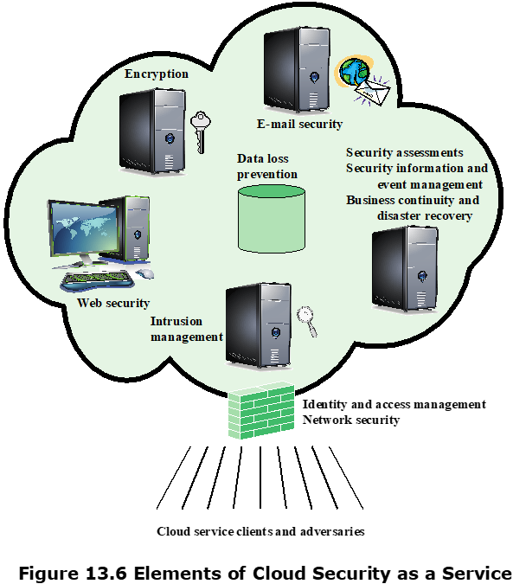
Cloud Security as a Service
Cloud Security as a Service (SecaaS), is one type of SaaS offered by a CSP.
provision of security applications and services via the cloud either to cloud-based infrastructure and software, or from the cloud to the customers’ on-premise system
SecaaS categories of service:
Identity and access management
Data loss prevention
Web security
E-mail security
Security assessments
Intrusion management
Security information and event management
Encryption
Business continuity and disaster recovery
Network security
Notes:
the provision of security applications and services via the cloud either to cloud-based infrastructure and software, or from the cloud to the customers’ on-premise system
The term security as a service has generally meant a package of security services
offered by a service provider that offloads much of the security responsibility from
an enterprise to the security service provider. Among the services typically provided
are authentication, anti-virus, antimalware/spyware, intrusion detection, and security
event management. In the context of cloud computing, cloud security as a service,
designated SecaaS, is a segment of the SaaS offering of a CSP.
The CSA defines SecaaS as the provision of security applications and services
via the cloud either to cloud-based infrastructure and software, or from the cloud to
the customers’ on-premise systems [CSA11]. The CSA has identified the following
SecaaS categories of service:
• Identity and access management
• Data loss prevention
• Web security
• E-mail security
• Security assessments
• Intrusion management
• Security information and event management
• Encryption
• Business continuity and disaster recovery
• Network security

Slide 20
OpenStack
Open-source software project of the OpenStack Foundation that aims to produce an open-source cloud operating system
The principal objective is to enable creating and managing huge groups of virtual private servers in a cloud computing environment
It provides multi-tenant IaaS, and aims to meet the needs of public and private clouds, regardless of size, by being simple to implement and massively scalable
Notes:
This section provides an overview of an open-source security module that is part
of the OpenStack cloud OS. OpenStack is an open-source software project of the
OpenStack Foundation that aims to produce an open-source cloud operating system
[ROSA14, SEFR12]. The principal objective is to enable creating and managing
huge groups of virtual private servers in a cloud computing environment. OpenStack
is embedded, to one degree or another, into data center infrastructure and cloud
computing products offered by Cisco, IBM, Hewlett-Packard, and other vendors. It
provides multi-tenant IaaS, and aims to meets the needs of public and private clouds
regardless of size, by being simple to implement and massively scalable.
OpenStack is embedded, to one degree or another, into data center infrastructure and cloud computing products

Slide 21
OpenStack
The OpenStack OS consists of a number of independent modules, each of which has a project name and a functional name
The security module for OpenStack is Keystone
Keystone provides the shared security services essential for a functioning cloud computing infrastructure, incl. Identity, Token, Service catalog, Policies
Notes:
The OpenStack OS consists of a number of independent modules, each of
which has a project name and a functional name. The modular structure is easy to
scale out and provides a commonly used set of core services. Typically, the components
are configured together to provide a comprehensive IaaS capability. However,
the modular design is such that the components are generally capable of being used
independently.
The security module for OpenStack is Keystone. Keystone provides the shared
security services essential for a functioning cloud computing infrastructure. It provides
the following main services:
• Identity: This is user information authentication. This information defines a
user’s role and permissions within a project, and is the basis for a role-based
access control (RBAC) mechanism. Keystone supports multiple methods of
authentication, including user name and password, Lightweight Directory
Access Protocol (LDAP), and a means of configuring external authentication
methods supplied by the CSC.
• Token: After authentication, a token is assigned and used for access control.
OpenStack services retain tokens and use them to query Keystone during
operations.
• Service catalog: OpenStack service endpoints are registered with Keystone to
create a service catalog. A client for a service connects to Keystone and determines
an endpoint to call based on the returned catalog.
• Policies: This service enforces different user access levels. Each OpenStack
service defines the access policies for its resources in an associated policy file.
A resource, for example, could be API access, the ability to attach to a volume,
or to fire up instances. These policies can be modified or updated by the cloud
administrator to control the access to the various resources.

Slide 22
Internet of Things (IoT)
IoT refers to the expanding interconnection of smart devices, ranging from appliances to tiny sensors
Embedding of short-range mobile transceivers into a wide array of gadgets and everyday items enables new forms of communication between people and things, and between things themselves
The Internet supports the interconnectivity usually through cloud systems
Notes:
The Internet of Things is the latest development in the long and continuing revolution
of computing and communications. Its size, ubiquity, and influence on everyday
lives, business, and government dwarf any technical advance that has gone before.
The Internet of Things (IoT) is a term that refers to the expanding interconnection
of smart devices, ranging from appliances to tiny sensors. A dominant theme
is the embedding of short-range mobile transceivers into a wide array of gadgets
and everyday items, enabling new forms of communication between people and
things, and between things themselves. The Internet now supports the interconnection
of billions of industrial and personal objects, usually through cloud systems.
The objects deliver sensor information, act on their environment, and in some
cases modify themselves, to create overall management of a larger system, like a
factory or city.
The IoT is primarily driven by deeply embedded devices. These devices are low-bandwidth,
low-repetition data capture, and low-bandwidth data-usage appliances
that communicate with each other and provide data via user interfaces. Embedded
appliances, such as high-resolution video security cameras, video VoIP phones, and a
handful of others, require high-bandwidth streaming capabilities. Yet countless products
simply require packets of data to be intermittently delivered.

Slide 23
Evolution
Information technology (IT)
PCs, servers, routers, firewalls, and so on, bought as IT devices by enterprise IT people, primarily using wired connectivity
Operational technology (OT)
Machines/appliances with embedded IT built by non-IT companies, such as medical machinery, SCADA, process control, and kiosks, bought as appliances by enterprise OT people, primarily using wired connectivity
Personal technology
Smartphones, tablets, and eBook readers bought as IT devices by consumers (employees) exclusively using wireless connectivity and often multiple forms of wireless connectivity
Sensor/actuator technology
Single-purpose devices bought by consumers, IT and OT people exclusively using wireless connectivity, generally of a single form, as part of larger systems
the Internet has gone through roughly four generations; the fourth generation is the IoT, marked by the use of billions of embedded devices
Notes:
With reference to the end systems supported, the Internet has gone through roughly
four generations of deployment culminating in the IoT:
1. Information technology (IT): PCs, servers, routers, firewalls, and so on, bought
as IT devices by enterprise IT people, primarily using wired connectivity.
2. Operational technology (OT): Machines/appliances with embedded IT built
by non-IT companies, such as medical machinery, SCADA (supervisory control
and data acquisition), process control, and kiosks, bought as appliances by
enterprise OT people, primarily using wired connectivity.
3. Personal technology: Smartphones, tablets, and eBook readers bought as IT
devices by consumers (employees) exclusively using wireless connectivity and
often multiple forms of wireless connectivity.
4. Sensor/actuator technology: Single-purpose devices bought by consumers, IT,
and OT people exclusively using wireless connectivity, generally of a single
form, as part of larger systems.
The fourth generation is usually thought of as the IoT, and which is marked by
using billions of embedded devices.

Slide 24
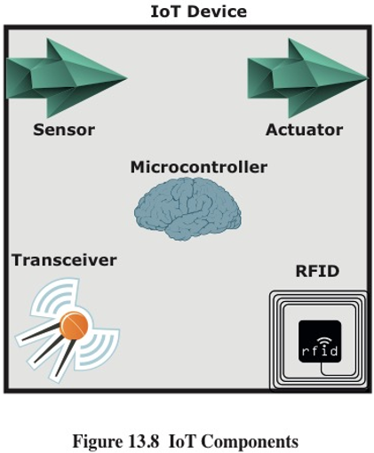
Components of an IoT Device
Sensor: A sensor measures some environment condition, e.g., temperature, humidity, pressure…
Actuator: An actuator exerts control over the environment
Microcontroller: an embedded chip that reads sensor inputs, performs computation and issues commands to the actuator
Transceiver: A transceiver contains the electronics needed to transmit and receive data, using wireless protocols such as cellular, Wi-Fi, ZigBee
Radio-frequency Identification (RFID): uses radio waves to identify items
Notes:
The key components of an IoT-enabled device are the following (see Figure 13.8):
• Sensor: A sensor measures some parameter of a physical, chemical, or biological
entity and delivers an electronic signal proportional to the observed
characteristic, either in the form of an analog voltage level or a digital signal.
In both cases, the sensor output is typically input to a microcontroller or other
management element.
• Actuator: An actuator receives an electronic signal from a controller and
responds by interacting with its environment to produce an effect on some
parameter of a physical, chemical, or biological entity.
• Microcontroller: The “smart” in a smart device is provided by a deeply embedded
microcontroller.
• Transceiver: A transceiver contains the electronics needed to transmit and
receive data. Most IoT devices contain a wireless transceiver, capable of communication
using Wi-Fi, ZigBee, or some other wireless scheme.
• Radio-frequency Identification (RFID): (RFID) technology, which uses radio
waves to identify items, is increasingly becoming an enabling technology for IoT.
The main elements of an RFID system are tags and readers. RFID tags are small
programmable devices used for object, animal, and human tracking. They come
in a variety of shapes, sizes, functionalities, and costs. RFID readers acquire and
sometimes rewrite information stored on RFID tags that come within operating
range (a few inches up to several feet). Readers are usually connected to a computer
system that records and formats the acquired information for further uses.

Slide 25
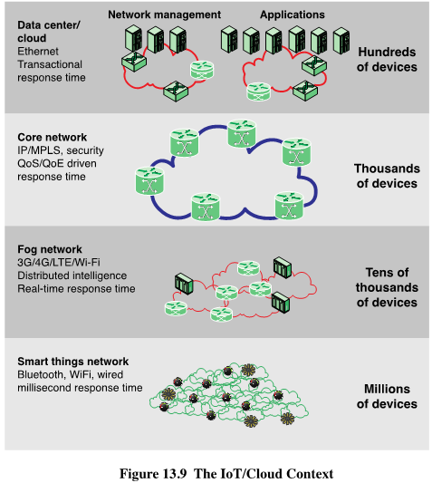
IoT in the context of a
complete enterprise network that includes third-party networking and cloud computing
elements.
Notes:
To better understand the function of an IoT, it is useful to view it in the context of a
complete enterprise network that includes third-party networking and cloud computing
elements. Figure 13.9 provides an overview illustration.

Slide 26
Edge
At the edge of a typical enterprise network is a network of IoT-enabled devices consisting of sensors and perhaps actuators
These devices may communicate with one another
A cluster of sensors may all transmit their data to one sensor that aggregates the data to be collected by a higher-level entity
A gateway interconnects the IoT-enabled devices with the higher-level communication networks
It performs the necessary translation between the protocols used in the communication networks and those used by devices
It may also perform a basic data aggregation function
Notes:
At the edge of a typical enterprise network is a network of IoT-enabled devices,
consisting of sensors and perhaps actuators. These devices may communicate with
one another. For example, a cluster of sensors may all transmit their data to one
sensor that aggregates the data to be collected by a higher-level entity. At this
level also there may also be a number of gateways. A gateway interconnects the
IoT-enabled devices with the higher-level communication networks. It performs
the necessary translation between the protocols used in the communication networks
and those used by devices. A gateway may also perform a basic data aggregation
function.

Slide 27
Fog
In many IoT deployments, massive amounts of data may be generated by a distributed network of sensors
Rather than store all of that data permanently (or at least for a long period) in central storage accessible to IoT applications, it is often desirable to do as much data processing close to the sensors as possible
The purpose of what is sometimes referred to as the edge computing level is to convert network data flows into information that is suitable for storage and higher-level processing
Processing elements at these levels may deal with high volumes of data and perform data transformation operations, resulting in the storage of much lower volumes of data
The following are examples of fog computing operations:
Evaluation
Formatting
Expanding/decoding
Distillation/reduction
Assessment
Notes:
In many IoT deployments, massive amounts of data may be generated by a distributed
network of sensors. For example, offshore oil fields and refineries can generate
a terabyte of data per day. An airplane can create multiple terabytes of data per
hour. Rather than store all of that data permanently (or at least for a long period) in
central storage accessible to IoT applications, it is often desirable to do as much data
processing close to the sensors as possible. Thus, the purpose of what is sometimes
referred to as the edge computing level is to convert network data flows into information
that is suitable for storage and higher-level processing. Processing elements
at these level may deal with high volumes of data and perform data transformation
operations, resulting in the storage of much lower volumes of data. The following are
examples of fog computing operations:
• Evaluation : Evaluating data for criteria as to whether it should be processed
at a higher level.
• Formatting : Reformatting data for consistent higher-level processing.
• Expanding/decoding : Handling cryptic data with additional context (such as
the origin).
• Distillation/reduction : Reducing and/or summarizing data to minimize the
impact of data and traffic on the network and higher-level processing systems.
• Assessment : Determining whether data represents a threshold or alert; this
could include redirecting data to additional destinations.

Slide 28
Fog
Generally fog computing devices are deployed physically near the edge of the IoT network near the sensors and other data-generating devices
Fog computing and fog services are expected to be a distinguishing characteristic of the IoT
Fog computing represents an opposite trend in modern networking from cloud computing
With cloud computing, massive, centralized storage and processing resources are made available to distributed customers over cloud networking facilities to a relatively small number of users
With fog computing, massive numbers of individual smart objects are interconnected with fog networking facilities that provide processing and storage resources close to the edge devices in an IoT
Fog computing addresses the challenges raised by the activity of thousands or millions of smart devices, including security, privacy, network capacity constraints, and latency requirements
The term fog computing is inspired by the fact that fog tends to hover low to the ground, whereas clouds are high in the sky
Notes:
Generally, fog computing devices they are deployed physically near the edge
of the IoT network; that is, near the sensors and other data-generating devices. Thus,
some of the basic processing of large volumes of generated data is offloaded and
outsourced from IoT application software located at the center.
Fog computing and fog services are expected to be a distinguishing characteristic
of the IoT. Fog computing represents an opposite trend in modern networking
from cloud computing. With cloud computing, massive, centralized storage and processing
resources are made available to distributed customers over cloud networking
facilities to a relatively small number of users. With fog computing, massive numbers
of individual smart objects are interconnected with fog networking facilities that
provide processing and storage resources close to the edge devices in an IoT. Fog
computing addresses the challenges raised by the activity of thousands or millions of
smart devices, including security, privacy, network capacity constraints, and latency
requirements. The term fog computing is inspired by the fact that fog tends to hover
low to the ground, whereas clouds are high in the sky.

Slide 29
Core
The core network, also referred to as a backbone network, connects geographically dispersed fog networks as well as providing access to other networks that are not part of the enterprise network
Typically the core network will use very high-performance routers, high-capacity transmission lines, and multiple interconnected routers for increased redundancy and capacity
The core network may also connect to high-performance, high-capacity servers such as large database servers and private cloud facilities
Some of the core routers may be purely internal, providing redundancy and additional capacity without serving as edge routers
Notes:
The core network, also referred to as a backbone network, connects geographically
dispersed fog networks as well as providing access to other networks that are not part
of the enterprise network. Typically, the core network will use very high-performance
routers, high-capacity transmission lines, and multiple interconnected routers for
increased redundancy and capacity. The core network may also connect to high-performance,
high-capacity servers such as large database servers and private cloud
facilities. Some of the core routers may be purely internal, providing redundancy and
additional capacity without serving as edge routers.

Slide 30
Cloud vs. Fog
 | Cloud | Fog
Location of processing/storage resources | Center | Edge
Latency | High | Low
Access | Fixed or wireless | Mainly wireless
Support for mobility | Not applicable | Yes
Control | Centralized/hierarchical (full control) | Distributed/hierarchical (partial control)
Service access | Through core | At the edge/on handheld device
Availability | 99.99% | Highly volatile/highly redundant
Number of users/devices | Tens/hundreds of millions | Tens of billions
Main content generator | Human | Devices/sensors
Content generation | Central location | Anywhere
Content consumption | End device | Anywhere
Software virtual infrastructure | Central enterprise servers | User devices
Table 13.4 Comparison of Cloud and Fog Features
Notes:
The cloud network provides storage and processing capabilities for the massive
amounts of aggregated data that originate in IoT-enabled devices at the edge.
Cloud servers also host the applications that (1) interact with and manage the IoT
devices, and (2) analyze the IoT-generated data.
Table 13.4 compares cloud and fog computing.

Slide 31
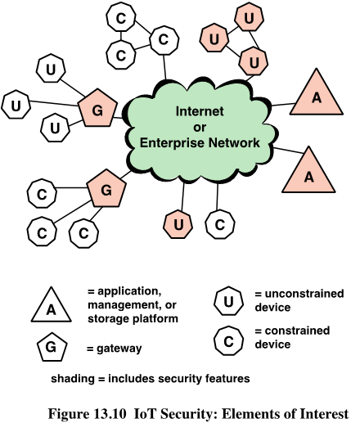
IoT Security
A: Application platforms, data storage servers, and network and security management systems at the center of the network that gather data from sensors, send control signals to actuators, and are responsible for managing the IoT devices and their communication networks.
C&U: IoT devices at the edge of the network, some may be simple resource-constrained devices, and some may be more powerful unconstrained devices.
G: Gateways that perform protocol conversion and other networking service on behalf of IoT devices.
A and G typically implements secure functions such as TLS and IPsec; U (unconstrained devices) may implement some security functions: C (constrained devices) have limited or no security features .
Notes:
IoT is perhaps the most complex and undeveloped area of network security. To
see this, consider Figure 13.10, which shows the main elements of interest for IoT
security. At the center of the network are the application platforms, data storage
servers, and network and security management systems. These central systems
gather data from sensors, send control signals to actuators, and are responsible
for managing the IoT devices and their communication networks. At the edge of
the network are IoT-enabled devices, some of which are quite simple constrained
devices, and some of which are more intelligent unconstrained devices. As well,
gateways may perform protocol conversion and other networking service on behalf
of IoT devices.
Figure 13.10 illustrates a number of typical scenarios for interconnection and
the inclusion of security features. The shading in Figure 13.10 indicates the systems
that support at least some of these functions. Typically, gateways will implement
secure functions, such as TLS and IPsec. Unconstrained devices may or may not
implement some security capability. Constrained devices generally have limited or no
security features. As suggested in the figure, gateway devices can provide secure communication
between the gateway and the devices at the center, such as application
platforms and management platforms. However, any constrained or unconstrained
devices attached to the gateway are outside the zone of security established between
the gateway and the central systems. As shown, unconstrained devices can communicate
directly with the center and support security functions. However, constrained
devices that are not connected to gateways have no secure communications with
central devices.

Slide 32
IoT Vulnerability
Hundreds of millions of IoT devices are vulnerable to attack
Chip manufacturers have strong incentives to produce their product as quickly and cheaply as possible
The device manufacturers focus is the functionality of the device itself
The end user may have no means of patching the system or, if so, little information about when and how to patch
This is certainly a problem with sensors, allowing attackers to insert false data into the network
It is potentially a graver threat with actuators, where the attacker can affect the operation of machinery and other devices
Notes:
In an often-quoted 2014 article, security expert Bruce Schneier stated that we are at
a crisis point with regard to the security of embedded systems, including IoT devices
[SCHN14]. The embedded devices are riddled with vulnerabilities and there is no
good way to patch them. The chip manufacturers have strong incentives to produce
their product with its firmware and software as quickly and cheaply as possible. The
device manufacturers choose a chip based on price and features and do very little
if anything to the chip software and firmware. Their focus is the functionality of
the device itself. The end user may have no means of patching the system or, if so, little
information about when and how to patch. The result is that the hundreds of millions
of Internet-connected devices in the IoT are vulnerable to attack. This is certainly a
problem with sensors, allowing attackers to insert false data into the network. It is
potentially a graver threat with actuators, where the attacker can affect the operation
of machinery and other devices.

Slide 33
IoT Security and Privacy Requirements
ITU-T Recommendation Y.2066 includes a list of security requirements for the IoT, incl. :
Communication security
Data management security
Service provision security
Integration of security policies and techniques
Mutual authentication and authorization
Security audit
Notes:
ITU-T Recommendation Y.2066 (Common Requirements of the Internet of Things,
June 2014) includes a list of security requirements for the IoT. This list is a useful
baseline for understanding the scope of security implementation needed for an
IoT deployment. The requirements are defined as being the functional requirements
during capturing, storing, transferring, aggregating, and processing the data of things,
as well as to the provision of services which involve things. These requirements are
related to all the IoT actors. The requirements are the following:
• Communication security: Secure, trusted, and privacy protected communication
capability is required, so unauthorized access to the content of data can be
prohibited, integrity of data can be guaranteed and privacy-related content of
data can be protected during data transmission or transfer in IoT.
• Data management security: Secure, trusted, and privacy protected data management
capability is required, so unauthorized access to the content of data can
be prohibited, integrity of data can be guaranteed, and privacy-related content
of data can be protected when storing or processing data in IoT.
• Service provision security: Secure, trusted, and privacy protected service provision
capability is required, so unauthorized access to service and fraudulent
service provision can be prohibited and privacy information related to IoT users
can be protected.
• Integration of security policies and techniques: The ability to integrate different
security policies and techniques is required, so as to ensure a consistent security
control over the variety of devices and user networks in IoT.
• Mutual authentication and authorization: Before a device (or an IoT user) can
access the IoT, mutual authentication and authorization between the device
(or the IoT user) and IoT is required to be performed according to predefined
security policies
.
• Security audit: Security audit is required to be supported in IoT. Any data
access or attempt to access IoT applications are required to be fully transparent,
traceable and reproducible according to appropriate regulation and laws.
In particular, IoT is required to support security audit for data transmission,
storage, processing, and application access.

Slide 34
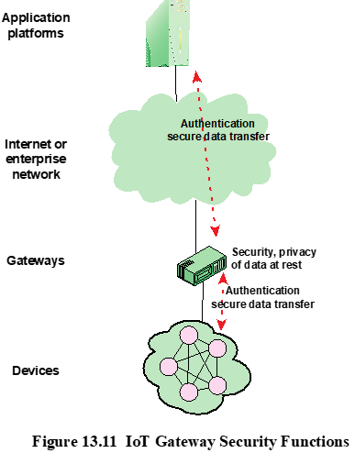
IoT Gateway Security Functions
ITU-T Recommendation Y.2067 (Common Requirements and Capabilities of a Gateway for Internet of Things Applications) specifies security functions that the gateway should implement, incl.
Support identification of each access to the connected devices.
Support authentication with devices, either mutual or one-way authentication
Support the security of the data that are stored in devices and the gateway, or transferred between the gateway and devices, or transferred between the gateway and applications.
Support mechanisms to protect privacy for devices and the gateway.
Support self-diagnosis and self-repair as well as remote maintenance.
Support firmware and software update.
…
Notes:
A key element in providing security in an IoT deployment is the gateway. ITU-T
Recommendation Y.2067 (Common Requirements and Capabilities of a Gateway for
Internet of Things Applications, June 2014) details specific security functions that
the gateway should implement, some of which are illustrated in Figure 13.11. These
consist of the following:
• Support identification of each access to the connected devices.
• Support authentication with devices. Based on application requirements and
device capabilities, it is required to support mutual or one-way authentication
with devices. With one-way authentication, either the device authenticates itself
to the gateway or the gateway authenticates itself to the device, but not both.
• Support mutual authentication with applications.
• Support the security of the data that are stored in devices and the gateway,
or transferred between the gateway and devices, or transferred between the
gateway and applications. Support the security of these data based on security
levels.
• Support mechanisms to protect privacy for devices and the gateway.
• Support self-diagnosis and self-repair as well as remote maintenance.
• Support firmware and software update.
• Support auto configuration or configuration by applications. The gateway is
required to support multiple configuration modes, for example, remote and
local configuration, automatic and manual configuration, and dynamic configuration
based on policies.
Some of these requirements may be difficult to achieve when they involve providing
security services for constrained devices. For example, the gateway should
support security of data stored in devices. Without encryption capability at the constrained
device, this may be impractical to achieve.
Note the Y.2067 requirements make a number of references to privacy requirements.
Privacy is an area of growing concern with the widespread deployment of
IoT-enabled things in homes, retail outlets, and vehicles and humans. As more things
are interconnected, governments and private enterprises will collect massive amounts
of data about individuals, including medical information, location and movement
information, and application usage.

Slide 35
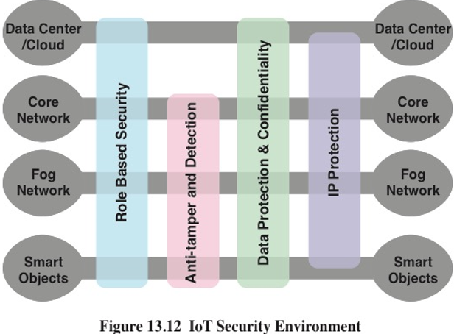
Cisco’s IoT Security Framework
Role-based security: RBAC systems assign access rights to roles instead of individual users. In turn, users are assigned to different roles, either statically or dynamically, according to their responsibilities
Anti-tamper and detection: This function is particularly important at the device and fog network levels, with components that are physically outside the area of the enterprise.
Data protection and confidentiality: These functions extend to all level of the architecture.
Internet protocol protection: Protection of data in motion from eavesdropping and snooping is essential between all levels.
Notes:
Cisco has developed a framework for IoT security [FRAH15] that serves as a useful
guide to the security requirements for IoT. Figure 13.12 illustrates the security
environment related to the logical structure of an IoT. The IoT model is a simplified
version of the World Forum IoT Reference Model. It consists of the following levels:
• Smart objects/embedded systems: Consists of sensors, actuators, and other embedded
systems at the edge of the network. This is the most vulnerable part of an
IoT. The devices may not be in a physically secure environment and may need to
function for years. Availability is certainly an issue. Network managers also need
to be concerned about the authenticity and integrity of the data generated by
sensors and about protecting actuators and other smart devices from unauthorized
use. Privacy and protection from eavesdropping may also be requirements.
• Fog/edge network: This level is concerned with the wired and wireless interconnection
of IoT devices. In addition, a certain amount of data processing
and consolidation may be done at this level. A key issue of concern is the wide
variety of network technologies and protocols used by the various IoT devices
and the need to develop and enforce a uniform security policy.
• Core network: The core network level provides data paths between network
center platforms and the IoT devices. The security issues here are those confronted
in traditional core networks. However, the vast number of endpoints to
interact with and manage creates a substantial security burden.
• Data center/cloud: This level contains the application, data storage, and network
management platforms. IoT does not introduce any new security issues at
this level, other than the necessity of dealing with huge numbers of individual
endpoints.
Within this four-level architecture, the Cisco model defines four general security
capabilities that span multiple levels:
• Role-based security: RBAC systems assign access rights to roles instead of
individual users. In turn, users are assigned to different roles, either statically
or dynamically, according to their responsibilities. RBAC enjoys widespread
commercial use in cloud and enterprise systems and is a well-understood tool
that can be used to manage access to IoT devices and the data they generate.
• Anti-tamper and detection: This function is particularly important at the device
and fog network levels but also extends to the core network level. All of these
levels may involve components that are physically outside the area of the enterprise
that is protected by physical security measures.
• Data protection and confidentiality: These functions extend to all level of the
architecture.
• Internet protocol protection: Protection of data in motion from eavesdropping
and snooping is essential between all levels.
Figure 13.12 maps specific security functional areas across the four layers of
the IoT model.

